Slide 1


Department of Computer Science and Engineering
CARDIOVASCULAR DISEASE PREDICTOR
Mrs.M.Divya M.E
Assistant Professor,
Dept Of CSE,
Rajalakshmi Engineering
College
Rishi Bala P
(220701224)

Slide 2
Problem Statement and Motivation
Cardiovascular diseases (CVD) are the leading cause of death globally.
Early detection is critical to prevent serious health issues or death.
Manual diagnosis is time-consuming and prone to errors.
There is a need for a quick, data-driven decision support system.
Machine learning models can help identify hidden patterns in patient data.

Slide 3
Existing System
Doctors rely on patient history, symptoms, and physical tests.
Traditional systems lack predictive intelligence.
Previous ML models used:Decision Trees SVM Neural Networks
Limitations:High complexityLess interpretableOverfitting with small datasets
Often lacks integration with modern electronic health records (EHR) for real-time analysis.
Many current models are "black-box" in nature, providing little insight into decision-making.

Slide 4
Objectives
To create an accurate, binary classification model using logistic regression.
To analyze and clean the cardiovascular dataset for better prediction.
To evaluate model performance using standard metrics.
To provide a user-friendly way to input patient data and get predictions.
To assist healthcare professionals with faster decision-making.
To identify the most significant features contributing to cardiovascular disease.
To minimize false positives and false negatives for reliable medical decisions.
To compare logistic regression with other models (optional) as a benchmark for future enhancement.

Slide 5
Abstract
This project focuses on predicting the likelihood of CVD using logistic regression.
A dataset containing medical data (e.g., age, BP, cholesterol) is used.
Preprocessing and feature selection improve model performance.
Results show that logistic regression can be a reliable baseline model.
Logistic regression is selected for its balance between accuracy and interpretability, making it ideal for medical use.
The model uses labeled historical data to learn patterns and predict disease presence.

Slide 6
Proposed System
An automated prediction system built on logistic regression.
Uses real-world patient health indicators.Flow:
Data Collection → Cleaning → Model Training → PredictionEmphasizes model simplicity and interpretability.
Can be integrated into hospital systems or mobile apps in the future.
Incorporates data preprocessing steps like feature scaling and encoding to ensure model accuracy.
Capable of being retrained periodically with new patient data for improved accuracy over time.

Slide 7
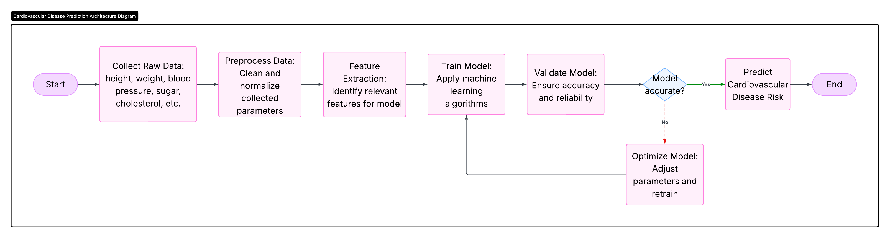
System Architecture

Slide 8
List of Modules
Data Collection – Source and features
Data Preprocessing – Cleaning, encoding, scaling
Model Training – Logistic regression fitting
Model Evaluation – Accuracy, precision, recall, ROC
Prediction Interface – (Optional) basic input/output demo

Slide 9
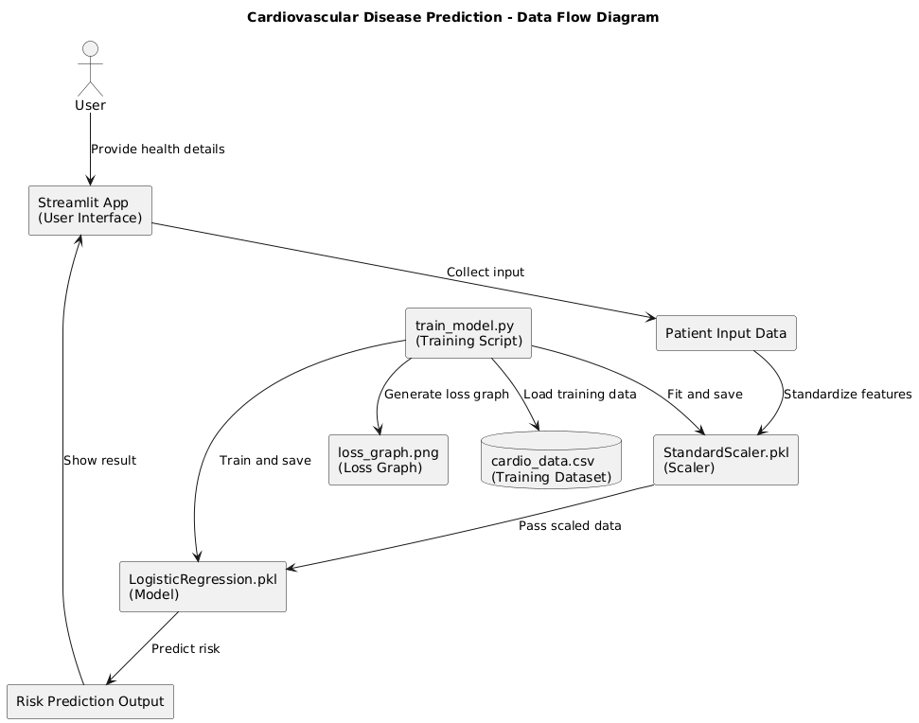
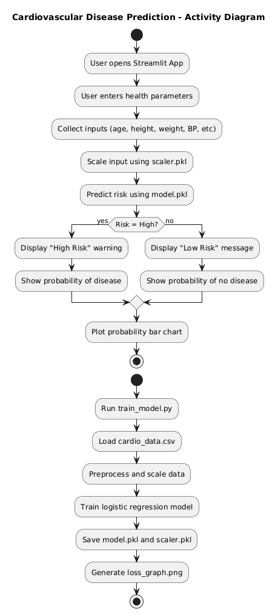
Functional Description for each modules with DFD and Activity Diagram
DATA FLOW DIAGRAM
ACTIVITY DIAGRAM

Slide 10
Implementation & Results of Module
IMPLEMENTATION: Github
RESULTS:
Accuracy: ~80–85% (depending on dataset)
Confusion matrix shows true/false positives/negatives
ROC curve: AUC ~0.8+

Slide 11
Conclusion & Future Work
Conclusion:
Logistic regression is effective and simple for predicting CVD
The model achieved satisfactory results
Future Work:
Use ensemble methods (Random Forest, XGBoost)
Add more real-time data
Deploy model as a web/mobile app
Incorporate real-time health monitoring data

Slide 12
References
[1] M. Dey, S. Adak, and S. Roy, "Prediction of Heart Disease Using Machine Learning Algorithms: A Comparative Study," International Journal of Engineering Research & Technology (IJERT), vol. 9, no. 7, pp. 1188–1192, 2020.
[2] M. Ghosh, A. Sinha, and P. K. Banerjee, "Machine Learning Approaches for Cardiovascular Disease Prediction: A Review," Current Diabetes Reviews, vol. 18, no. 3, pp. 1–12, 2022.
[3] S. Haq et al., "Heart Disease Prediction Using Machine Learning Techniques: A Review," International Journal of Engineering and Advanced Technology (IJEAT), vol. 8, no. 6S3, pp. 1396–1399, 2019.
[4] Y. Xu, H. Goodacre, "On Splitting Training and Validation Set: A Comparative Study of Cross-Validation, Bootstrap and Holdout Methods," Journal of Chemical Information and Modeling, vol. 58, no. 3, pp. 596–603, 2018.

Slide 13
Thank You

